Slide 1
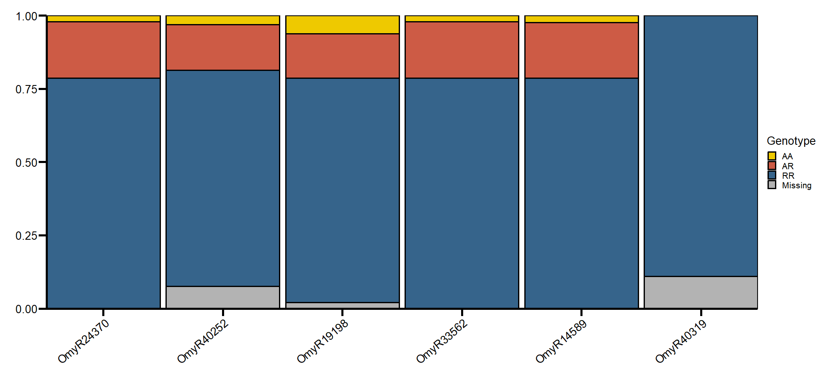
Genotype Frequency

Slide 2
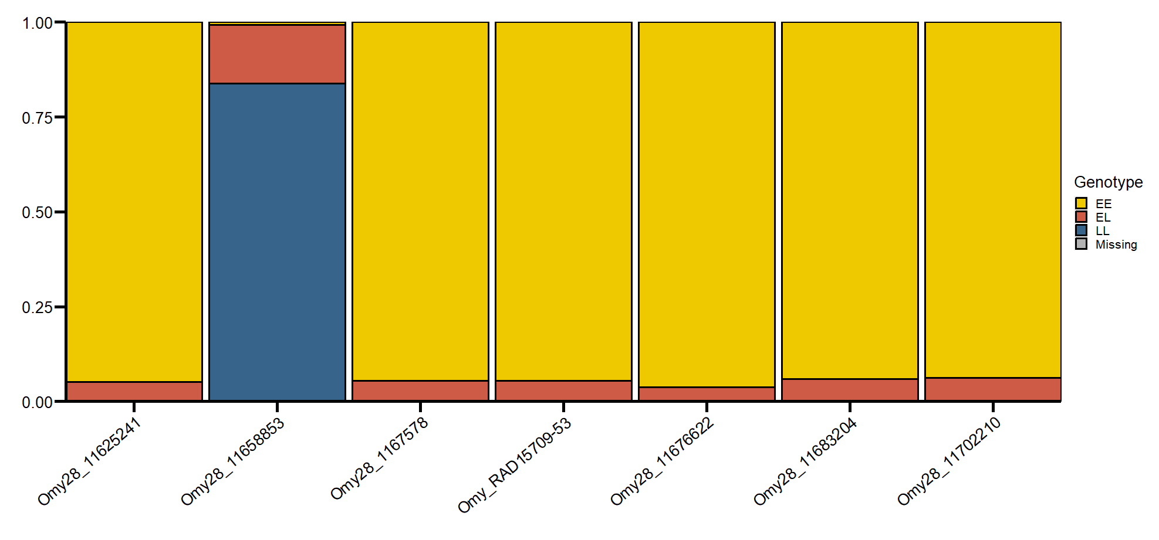
Genotype Frequency

